Slide 1
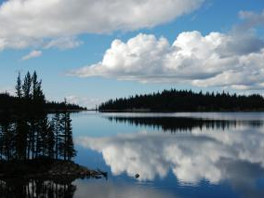

Sustainability -
A Designer’s Perspective
Stephanie Gould
October 31, 2016

Slide 2
Sustainable Rating Systems
LEED for buildings
SITES for landscapes
STAR community rating system
INVEST & FHWA Sustainable highways
Envision for infrastructure
Notes:
Many systems that examine design and construction, each with a specific focus
Public opinion
These are just a few examples. There are also third party certifications for building products, rainforest friendly
Each has a slightly different meaning
Method of measuring achieving goals

Slide 3



Overview
Introducing Envision
The Value of Envision
Envision in Action –
Grand Bend WWTF

Slide 4
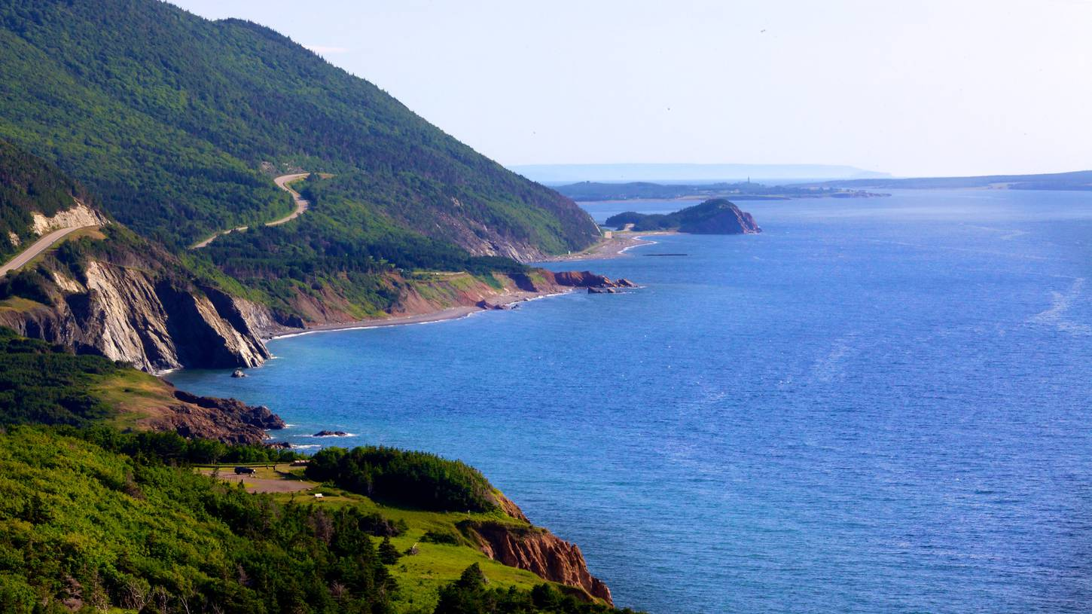
Introducing Envision
Notes:
Image: Cabot Trail, Cape Breton

Slide 5





A Joint Collaboration
ISI Founding Organizations
Notes:
Envision™ was developed in joint collaboration between the Zofnass Program for Sustainable Infrastructure at the Harvard University Graduate School of Design and the Institute for Sustainable Infrastructure.
The Institute for Sustainable Infrastructure is a not-for-profit education and research organization founded by the American Public Works Association, the American Council of Engineering Companies and the American Society of Civil Engineers.
Each founding organization was developing a sustainable infrastructure program and saw the need for a standardized framework for classification of sustainability practices. The organizations decided to work together to form ISI to produce and administer the framework as a National Standard for Sustainable Achievement. There was collaboration with Federal Agencies, Universities, Consultants, Professional Societies, Municipalities. This tool was vetted by industry experts.
Envision was officially launched in 2012

Slide 6



Envision™ provides a holistic framework for planning, evaluating and rating the community, environmental, and economic benefits of
all types and sizes of infrastructure projects…
- Institute for Sustainable Infrastructure
www.sustainableinfrastructure.org
Notes:
The Envision™ Rating System is a series of tools for evaluating the sustainability of civil infrastructure. The overall purpose is to foster a dramatic and necessary improvement in the performance and resiliency of our physical infrastructure across the full dimensions of sustainability.
EnvisionTM timeline:
First version of Envision for industry review and comment came out July 5, 2011
ISI and the Zofnass Program at Harvard merged their two systems in the fall of 2011
Second version of Envision came out February 16, 2012 for self-assessments
Project verification began in September 2012
First project was verified for award in 2013
Developed by the Institute for Sustainable Infrastructure and Harvard GSD Sustainable Infrastructure Program
ISI: founded by American Council of Engineering Companies (ACEC), American Public Works Association (APWA) and American Society of Civil Engineers (ASCE)
Framework for evaluating infrastructure performance and intended to foster improvement in performance, resiliency, long-term sustainability by:
Guiding planning and design processes; Comparing design options – making and defending choices; Evaluating performance across key areas; Publicly recognizing projects.
Applies to all types & sizes of civil infrastructure
Can eventually be applied at any stage of the project’s life-cycle though today’s Envision is meant to be applied at the planning and design phases, as opposed to operations and maintenance.
Envision does not cover buildings, except for process-type facilities as buildings are well covered by LEED (new & existing), BOMA BESt (existing, Canada), Green Globes (existing)

Slide 7




The Envision Framework
Think LEED®
but focused on all types of ‘horizontal’ infrastructure
Objectives are outcome-based
with a goal of no net impact or restorative performance
60 credits
across 5 categories
Credits are flexible
and reward design
and innovation
Notes:
Envision
Think LEED®, only enhanced and applicable to all types of infrastructure
Objectives are outcome based – with a goal of no impact or restorative performance
55 credits across 5 categories
Credits are flexible and reward design and innovation

Slide 8
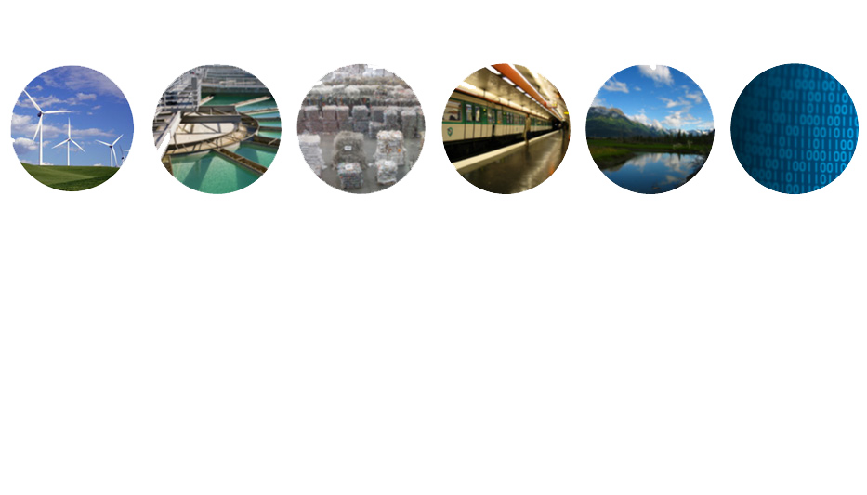
Applicable to most types & sizes of infrastructure projects
ENERGY
WATER
WASTE
TRANSPORT
LANDSCAPE
INFORMATION
Envision Addresses the public side of infrastructure
Broader concern for long term and community impacts
Reflects the fact that no single entity is typically responsible for infrastructure – collaboration is key
Infrastructure largely publicly funded – must respond to public and taxpayer needs
Notes:
First Point:
Envision is a system that is applicable to all types and sizes of infrastructure projects
Most sustainability rating systems for infrastructure are sector specific or regionally based. Before Envision, there was no comprehensive system in either Canada or the US that covered all aspects of infrastructure.
Envision is designed to fill this need. Envision draws on a number of existing standards such as LEED, Greenroads, CEEQUAL, and Sustainable Sites. It is meant to address all environmental, economic and social aspects of a project, rather than a single project attribute, or a small sub-set of attributes. It recognizes the value of other standards, and uses those that are considered to be best practice. In this way Envision does not attempt to “re-invent the wheel”, rather it is meant to amalgamate and standardize existing frameworks to improve planning and design processes, and recognize genuine leadership.
Second Point:
Infrastructure elements aren’t like buildings
Buildings:
- Are generally under the control of a single entity
- One can readily optimize building systems
- There is generally limited mandate or interest in the broader spectrum of sustainability
- Building owners and managers are not legally responsible for addressing most stakeholder concerns
On the other hand, for Infrastructure,
- There is no single responsible entity
- Multiple departments with different issues, agendas, schedules, budgets, customers are involved
- Requires integration at the city/community and regional levels
- Public funding means that designs must be responsive to public needs

Slide 9





‘Credits’ in Five Categories
Quality of Life
13 credits
Leadership
10 credits
Resource Allocation
14 credits
Natural World
15 credits
Climate + Risk
8 credits
1 Purpose
QL 1.1 Improve Community Quality of Life
QL 1.2 Simulate Sustainable Growth & Development
QL 1.3 Develop Local Skills + Capabilities
2 Wellbeing
QL 2.1 Enhance Public Health + Safety
QL 2.2 Minimize Noise and Vibration
QL 2.3 Minimize Light Pollution
QL 2.4 Improve Community Mobility + Access
QL 2.5 Encourage Alterative Modes of Transport
QL 2.6 Improve Accessibility, Safety + Wayfinding
3 Community
QL 3.1 Preserve Historic + Cultural Resources
QL 3.2 Preserve Views + Local Character
QL 3.3 Enhance Public Space
QL0.0 Innovate or Exceed Credit Requirements
1 Collaboration
LD 1.1 Provide Effective Leadership + Commitment
LD 1.2 Establish a Sustainability Management System
LD 1.3 Foster Collaboration + Teamwork
LD 1.4 Provide for Stakeholder Involvement
2 Management
LD 2.1 Pursue By-Product Synergy Opportunities
LD 2.2 Improve Infrastructure Integration
3 Planning
LD 3.1 Plan for Long-Term Monitoring + Maintenance
LD 3.2 Address Conflicting regulations + Policy
LD 3.3 Extend Useful Life
LD 0.0 Innovate or Exceed Credit Requirements
1 Materials
RA 1.1 Reduce Net Embodied Energy
RA 1.2 Support Sustainable Procurement Practices
RA 1.3 Use Recycled Materials
RA 1.4 Use Regional Materials
RA 1.5 Divert Waste from Landfills
RA 1.6 Reduce Excavated Materials Taken Off Site
RA 1.7 Provide for Deconstruction + Recycling
2 Energy
RA 2.1 Reduce Energy Consumption
RA 2.2 Use Renewable Energy
RA 2.3 Commission + Monitor Energy Systems
3 Water
RA 3.1 Protect Fresh Water Availability
RA 3.2 Reduce Potable Water Consumption
RA 3.3 Monitor Water Systems
RA 0.0 Innovate or Exceed Credit Requirements
1 Siting
NW 1.1 Preserve Prime Habitat
NW 1.2 Protect Wetlands + Surface Water
NW 1.3 Preserve Prime Farmland
NW 1.4 Avoid Adverse Geology
NW 1.5 Preserve Floodplain Functions
NW 1.6 Avoid Unsuitable Development on
Steep Slopes
NW 1.7 Preserve Greenfields
2 Land + Water
NW 2.1 Manage Stormwater
NW 2.2 Reduce Pesticide + Fertilizer Impacts
NW 2.3 Prevent Surface + Groundwater
Contamination
3 Biodiversity
NW 3.1 Preserve Species Biodiversity
NW 3.2 Control Invasive Species
NW 3.3 Restore Disturbed Soils
NW 3.4 Maintain Wetland + Surface Water Functions
NW 0.0 Innovate or Exceed Credit Requirements
1 Emissions
CR 1.1 Reduce Greenhouse Gas Emissions
CR 1.2 Reduce Air Pollutant Emissions
2 Resilience
CR 2.1 Assess Climate Threat
CR 2.2 Avoid Traps + Vulnerabilities
CR 2.3 Prepare For Long-Term Adaptability
CR 2.4 Prepare for Short-Term Hazards
CR2.5 Manage Heat Island Effects
NW 0.0 Innovate or Exceed Credit Requirements
Notes:
5 categories, 60 credits
This looks a lot like LEED,
If used as an outline for a design study report it forces a designer to consider

Slide 10
Project ‘scoring’ determined by performance on full constellation of metrics / credits, each with their own guidance and directives

Slide 11




The Envision rating system
4 levels of certification available:
20%
30%
40%
50%
Notes:
Bronze: 20-29% of applicable credits achieved
Silver: 30-39% of applicable credits achieved
Gold: 40-49% of applicable credits achieved
Platinum: 50%+ of applicable credits achieved

Slide 12
Envision is a design philosophy and framework
Not prescriptive
Allows for flexibility

Slide 13
Public agency challenges
Limited finances – need for multi-benefit projects to achieve community goals
Desire to drive incremental change
Need to ‘walk the talk’
Lack of tools to compel desired behaviour
Political and public pressures to perform
What’s ‘coming down the pipe’ – federal, provincial
Notes:
Infrastructure is typically one of the largest components of a municipality’s operating/capital budget, and it forms the backbone for community structure. Therefore it is one of the best mechanisms for a municipality to effect change

Slide 14
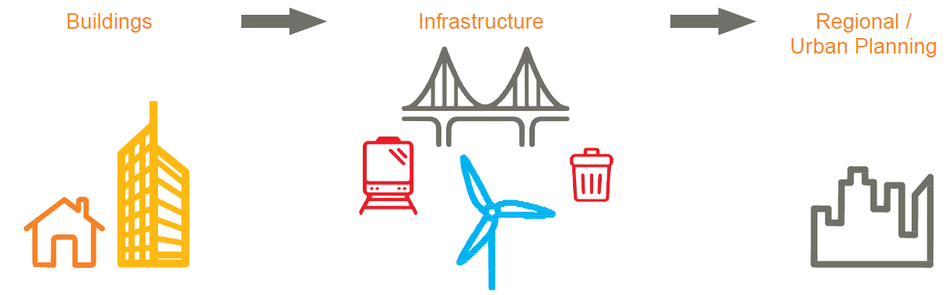
Natural Evolution in Design
Where we have been:
Multiple Rating Systems
Building Scale
(e.g. LEED®)
Where we are:
Infrastructure
Project Scale
(Envision)
Where we are headed:
City-Scale sustainable
Planning
(the next challenge)

Slide 15
Triple Bottom Line - Infrastructure
Technical Challenges
Social and Environmental Impacts
Financial Cost

Slide 16



‘Making it Make Sense’
Growing Public Interest
Too Many Metrics
Need for Easy-to-Understand Language

Slide 17
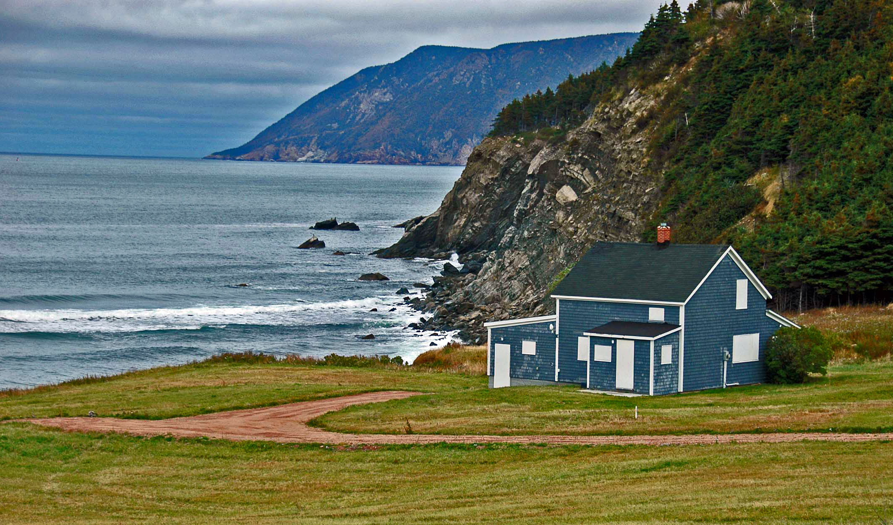
Value of Envision
Notes:
Image: Capstick, Cape Breton

Slide 18
Two Primary Value Propositions:
1. Enhancing quality of design
2. Communications platform

Slide 19

As a Framework & Design Tool
Challenges us to foster innovation in design
Think comprehensively
Encourages interdisciplinary collaboration
Stimulate “out-of-box” solutions
Notes:
Envision provides vocabulary and metrics to describe sustainability in real, measurable terms.
Think comprehensively
Stimulate “out-of-box” solutions
Leads to improved overall design
Think LEED, but for infrastructure
Envision can add value to design through:
Helping to determine the right project
Consideration of the full project lifecycle
Incorporating stakeholder needs and concerns
Facilitating integration with existing assets & networks
Identifying synergies and cost efficiencies
Benefits
Owner with marketing and recognition
Designer by focusing design and providing resources
Community with involvement and design improvements

Slide 20
How does this play out in the design process?
Using Envision Framework as Reference Point
Identify Key Project Priorities & Set Goals
Design Innovation to Obtain Goals
Translation of Requirements to Design / Construction Partners
Assessment of Potential Design Options
Focus
Assess
Innovate
Communicate
Progression of Project Timeline / Technical Design
Award Submission
Notes:
Our experience applying Envision has directed our approach
As industry leaders we have discovered ways to streamline Envision implementation
We have created a suite of customizable tools and resources
Envision Roadmap Tool - Tailored reference that provides guidance on potential actions, types of documentation and strategies that can be employed to elevate project performance and scoring potential
Additional companion tools to track documentation and coordinate the design process across disciplines

Slide 21
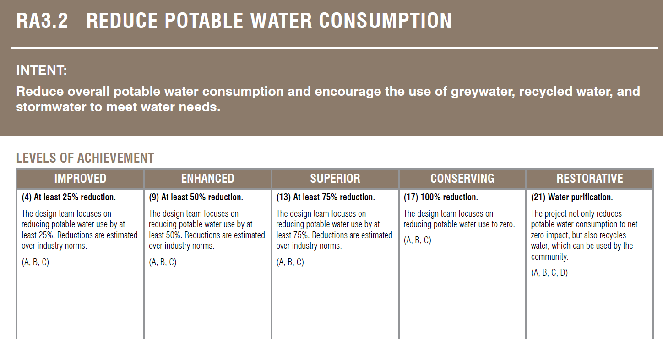
Incremental Improvement
Credit number and title
Purpose of
the credit
How the credit will be measured
  RESTORATIVE
  Performance that restores natural or social systems.
  CONSERVING
  Performance that achieved zero negative impact.
  SUPERIOR
  Performance that is noteworthy but not conserving.
  ENHANCED
  Performance that is on the right track.
IMPROVED
Performance that is above conventional.
Notes:
In the manual you will see two pages of explanation and instructions for each of the 60 credits. At the top of each credit there is:
A credit number and title;
An intent statement summarizing the purpose of the credit.
A metric statement indicating how performance is assessed; and
The total points available for the credit.
Each credit description in this Envision™ Guidance Manual includes an intent statement and metric, levels of achievement, a description, ways to advance to higher achievement levels, evaluation criteria and documentation, sources, and related credits.
Let’s look at each part.
First, you see the credit name, intent, and metric.

Slide 22
Qualitative credit example
Quality of Life—Credit QL3.3: Enhance Public Space
Levels of Achievement
Improved (1 pts) | No long-term impacts to existing public space
Enhanced (3 pts) | No adverse impacts, consideration given to creation of new public space(s)
Superior (6 pts) | Identify and implement new public space(s) or enhance existing public space(s)
Conserving (11 pts) | Creating new public space(s); addition of recreational facilities to an existing resource; improving access; demonstrated stakeholder satisfaction
Restorative (13 pts) | Substantial restoration of existing plazas, parks, recreational areas, or wildlife areas is delivered by the project
Project team must demonstrate the extent to which consideration for new public space(s) was incorporated into the design

Slide 23

Quantitative credit example
Natural World—Credit NW1.7: Preserve Greenfields
Levels of Achievement
Improved (3 pts) | At least 25% of developed area to be located on a greyfield
Enhanced (6 pts) | At least 50% of developed area to be located on a greyfield
Superior (10 pts) | At least 75% of developed area to be located on a greyfield
Conserving (15 pts) | 100% of developed area to be located on a greyfield
Restorative (23 pts) | Project to be located on a brownfield (contaminated site to be remediated)
Project team must demonstrate the extent to which their project preserves greenfields by locating development on greyfield or brownfield sites

Slide 24




As a Communication Platform
Opportunity to engage public and stakeholders
Formal ISI award
available for high-achieving projects
Boosts PR
reputation, and the prestige of the project
Justifies & Validates
commitments to sustainability
Encourages
community and stakeholder buy-in
Notes:
A great tool to demonstrate specifically how a project is promoting sustainabliity and measures it.
Envision can be used as a tool for two-way communication between the project owner and the public.

Slide 25
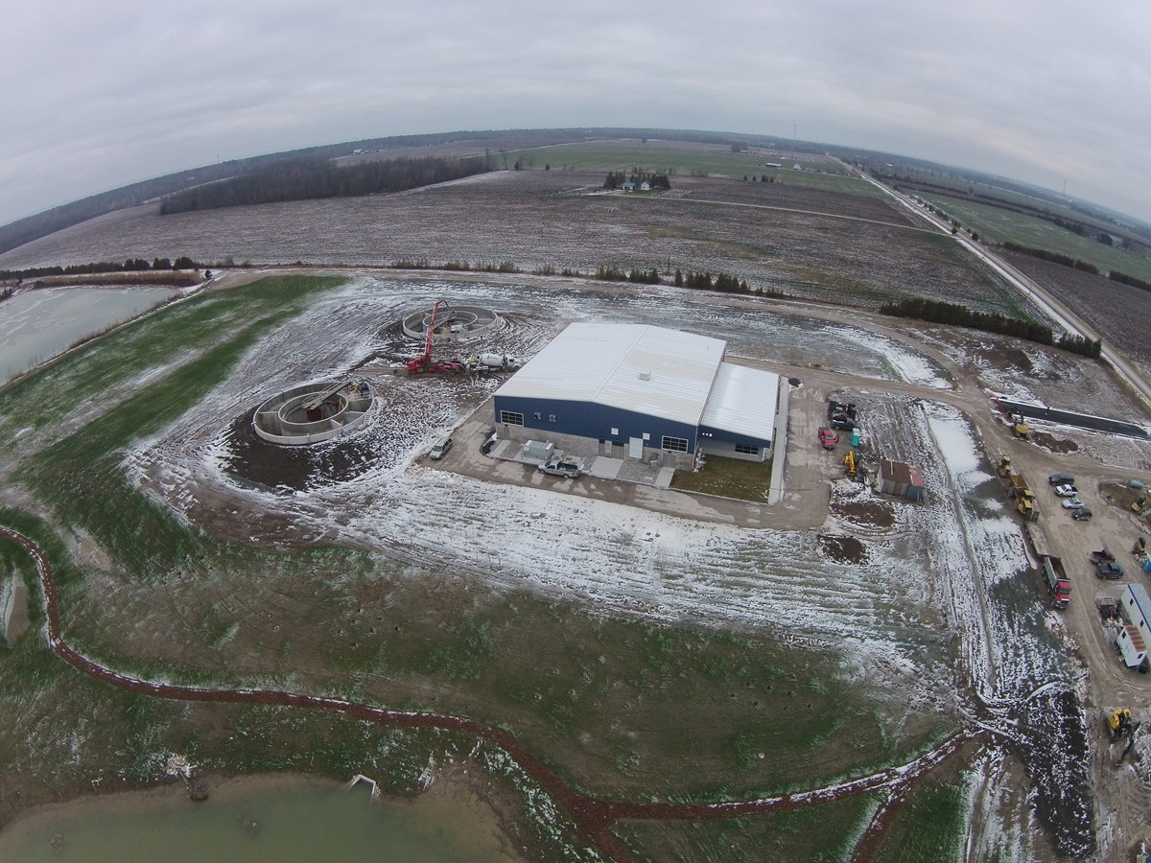
Envision in Action

Slide 26
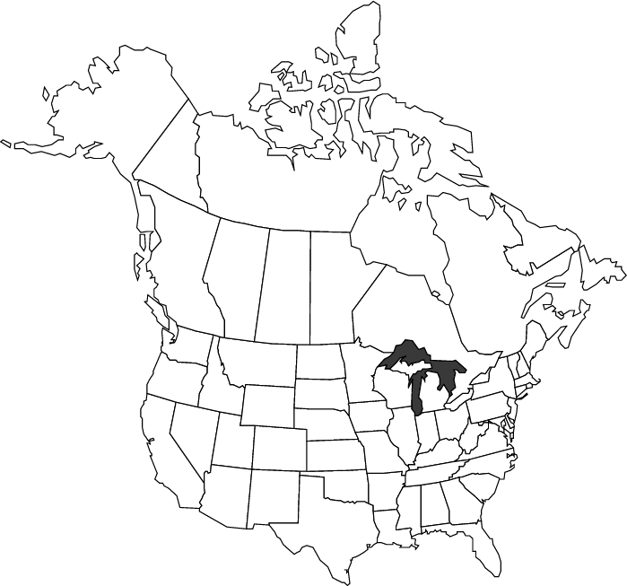



















A Representative Sample…
Notes:
19 projects listed on website as certified the first one is in Alaska was in 2013
The William Jack Hernandez Sport Fish Hatchery in Anchorage, Alaska
The 141,000-square foot hatchery facility is the largest indoor sport fish hatchery in North America, and contains many sustainable features, including sophisticated recirculation technology that reduces by 95 percent the water and energy normally used by conventional hatcheries. The sustainability aspects of the Fish Hatchery that garnered high-level ratings included leaving the brownfield site cleaner than before, saving water and energy, keeping Ship Creek clean, and building public education into its design. Additional higher levels of achievement were concentrated in several Envision structure credit categories, including the following:
Leadership Category: Pursued by-product synergy: The project formed a partnership to transfer waste from the operations of the facility as input to another facility, and evaluated the potential to make use of warm water from a neighboring industry.
Quality of Life: Improved the net quality of life of all communities affected by the project and mitigated community impacts. The project improved user accessibility, safety and wayfinding of the site and surrounding areas. It also enhanced public space including improvement of public parks, plazas, recreational facilities, or wildlife refuges to enhance community livability.
Resource Allocation: Reduced energy use: The project piloted and later implemented a full scale, highly efficient, recirculated aquaculture system that reduced the energy needed to heat the process water, ventilation, and building heating by approximately 88%, while significantly reducing operating costs and maintaining production goals.
Natural World: Preserved greenfields: The project included the environmental restoration of a former military brownfield and greyfield site, including the cleanup of contaminated soils.
“The William Jack Hernandez Sport Fish Hatchery provides a great fit for the first-ever ISI Envision project award. As the heart of Alaska’s sport fish stocking program, and the largest indoor sport fish hatchery in North America, it’s also the largest application of water recirculation technology for a hatchery. The sustainability of this project guided the vision and development of every aspect of the hatchery, and all facets of building and site design incorporated sustainability principles that will last far into the future,” said ISI Executive Director William Bertera
Edmonton – First adaptation of Envision checklist to evaluate relative performance for proposed urban development
25% of ENV SPs in N.A. are public works & other government staff

Slide 27
Select Certified Projects
LA County Sun Valley Watershed
South Los Angeles Wetland Park
WJ Hernandez Sport Fish Hatchery
Tarrant Regional Water District Pipeline

Slide 28
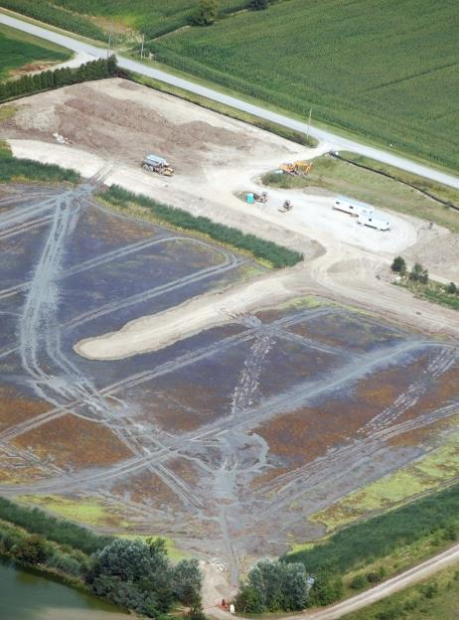
Envision is Being Used
Grand Bend WWTF
Challenge
Designing an innovative wastewater plant that meets current and future needs, addresses environmental and social concerns, while being affordable.
Notes:
Explain how this project incorporated the Envision Framework during design
Odours
Design flexibility
Water quality
Natural environment restoration
Stakeholder engagement
Economic sustainability
Facility design by others was overbudget and not acceptable to client. Stantec was brought in to rethink the project. It ended up below budget, a better design and included facilities for the fire department to fill their trucks and an educational component for school children in addition to serving its intended purpose in a better and more sustainable way.

Slide 29


Framework Example -
Grand Bend WWTF
Solution
Used Envision as a design aide to:
Address environmental/
social challenges
Improve design performance and resiliency
Cut facility cost by $9 million
($25M $16M)

Slide 30
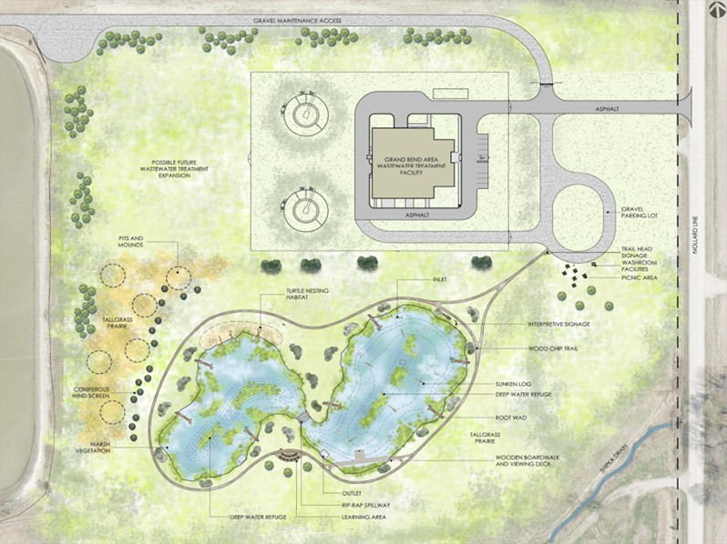
Grand Bend WWTP, Ontario
Notes:
Needed to build a new plant, needed to build up the site so they dug a big hole to source material….
Key sustainable features include a
constructed wetland to support native wildlife species and further buffer treated effluent,
flexible design that makes the facility responsive to changing sewage flows,
reduced construction and operational costs,
construction within the boundaries of the original facility's footprint to protect prime farmland, and
trails and interpretive signage to encourage community visitors.
Children’s activity booklet
Advanced treatment research

Slide 31

Innovation Through Envision to Add Value
Restored native habitats
Opened facility to the public
Enhanced water quality beyond requirements
“The Municipality of Lambton Shores is excited to have achieved ISI Envision verification of the Grand Bend Area WWTF with our partners – the Municipality of South Huron and Stantec…We hope this project will pave the way for others in Canada to pursue Envision verification in their infrastructure designs.”
- Mayor Bill Weber

Slide 32
Summary
Envision offers the following benefits:
Opportunity to pursue incremental improvements
Metric for incorporating ‘soft’ considerations into design decisions – ‘walking the talk’
Consistent framework for comparing and contrasting benefits
Platform for encouraging collaboration and design innovation
Offers avenue for compelling other project delivery partners to make progress on sustainable development objectives
Strong (and growing) support and recognition
Potential to demonstrate leadership

Slide 33
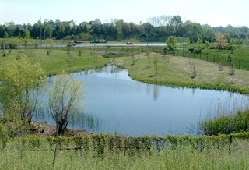
Questions?

Slide 34
Thank You
Stephanie Gould, PE
E: Stephanie.Gould@stantec.com
T: (907) 343-5235

